Slide 1

Chapter 12
Transmission
Control Protocol
Objectives
Upon completion you will be able to:
Be able to name and understand the services offered by TCP
Understand TCP’s flow and error control and congestion control
Be familiar with the fields in a TCP segment
Understand the phases in a connection-oriented connection
Understand the TCP transition state diagram
Be able to name and understand the timers used in TCP
Be familiar with the TCP options

Slide 2
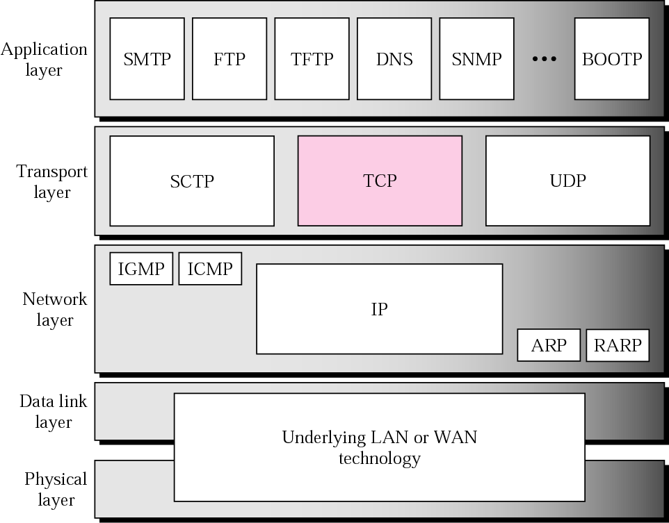
Figure 12.1 TCP/IP protocol suite

Slide 3
12.1 TCP SERVICES
We explain the services offered by TCP to the processes at the application layer.
The topics discussed in this section include:
Process-to-Process Communication
Stream Delivery Service
Full-Duplex Communication
Connection-Oriented Service
Reliable Service

Slide 4
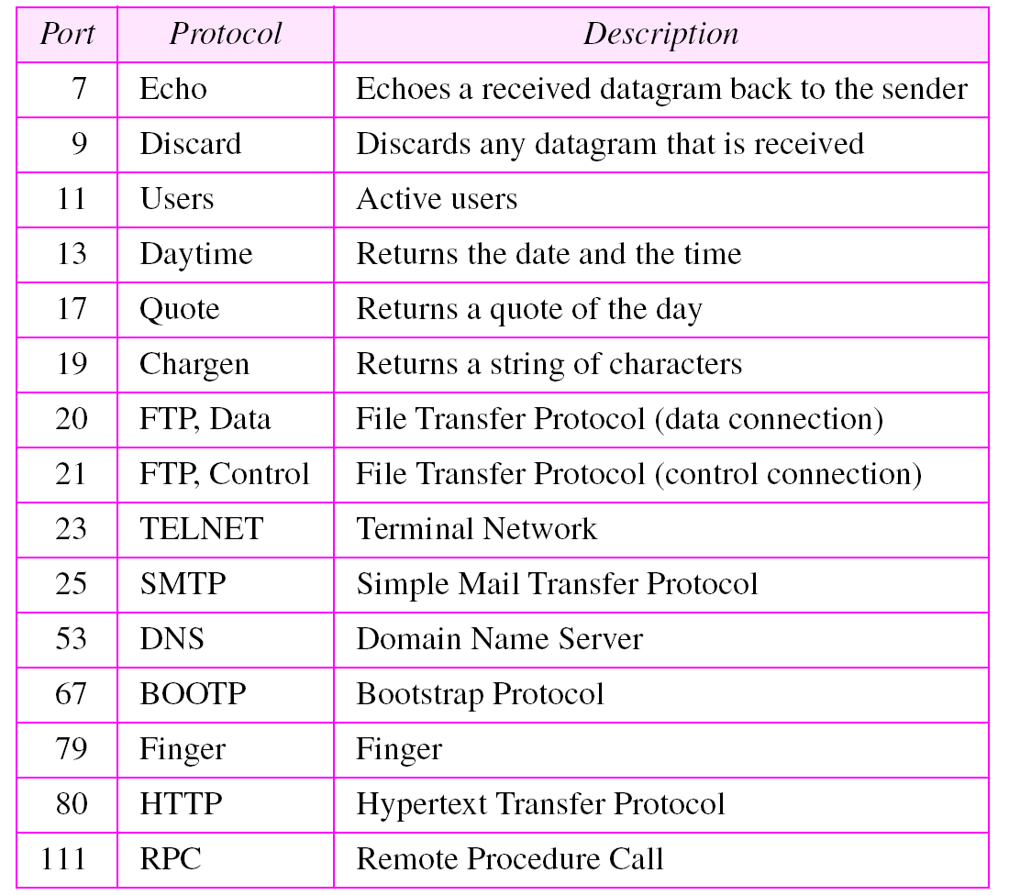
Table 12.1 Well-known ports used by TCP

Slide 5
Example 1
As we said in Chapter 11, in UNIX, the well-known ports are stored in a file called /etc/services. Each line in this file gives the name of the server and the well-known port number. We can use the grep utility to extract the line corresponding to the desired application. The following shows the ports for FTP.
$ grep ftp /etc/services
ftp-data 20/tcp
ftp-control 21/tcp

Slide 6
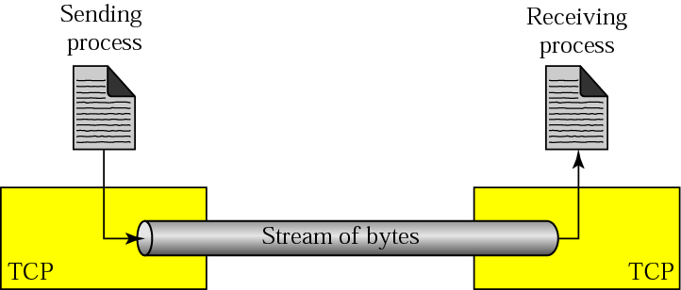
Figure 12.2 Stream delivery

Slide 7
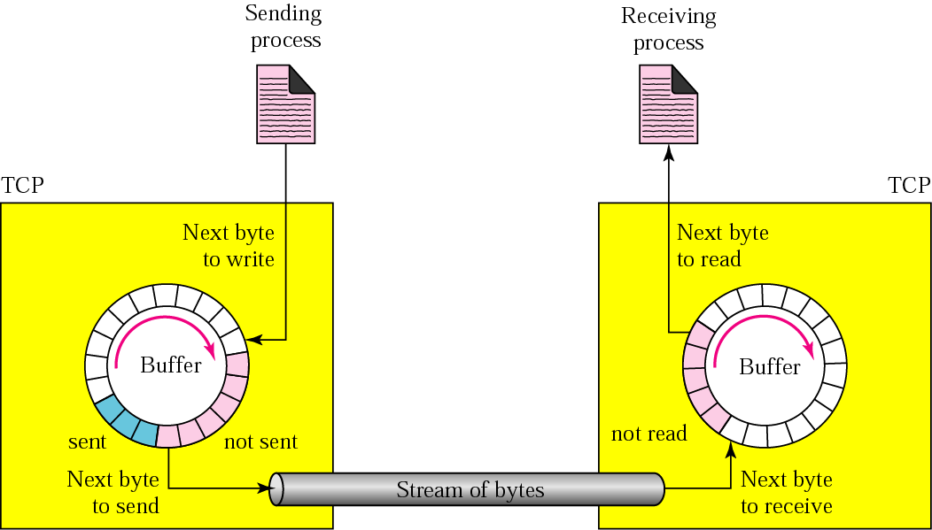
Figure 12.3 Sending and receiving buffers

Slide 8
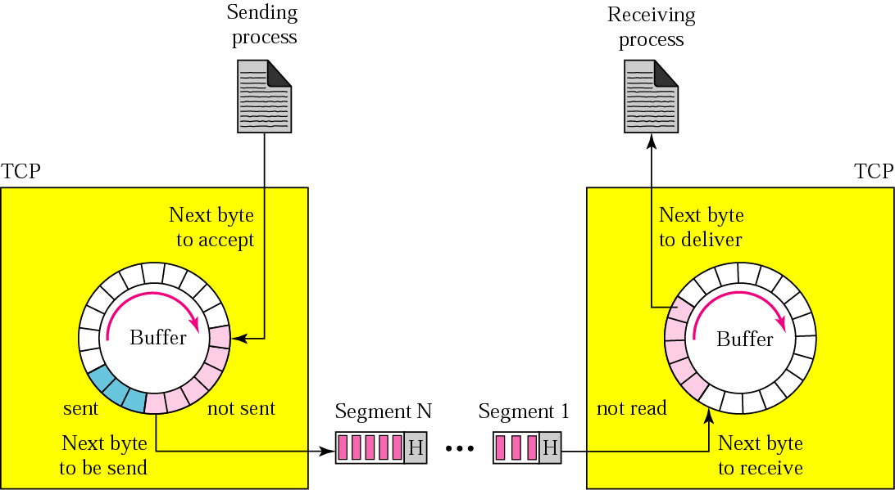
Figure 12.4 TCP segments

Slide 9
12.2 TCP FEATURES
To provide the services mentioned in the previous section, TCP has several features that are briefly summarized in this section.
The topics discussed in this section include:
Numbering System
Flow Control
Error Control
Congestion Control

Slide 10

Note:
The bytes of data being transferred in each connection are numbered by TCP. The numbering starts with a randomly generated number.

Slide 11
Example 2
Suppose a TCP connection is transferring a file of 5000 bytes. The first byte is numbered 10001. What are the sequence numbers for each segment if data is sent in five segments, each carrying 1000 bytes?
Solution
The following shows the sequence number for each segment:
Segment 1 ➡ Sequence Number: 10,001 (range: 10,001 to 11,000)
Segment 2 ➡ Sequence Number: 11,001 (range: 11,001 to 12,000)
Segment 3 ➡ Sequence Number: 12,001 (range: 12,001 to 13,000)
Segment 4 ➡ Sequence Number: 13,001 (range: 13,001 to 14,000)
Segment 5 ➡ Sequence Number: 14,001 (range: 14,001 to 15,000)

Slide 12
Note:
The value in the sequence number field of a segment defines the number of the first data byte contained
in that segment.

Slide 13
Note:
The value of the acknowledgment field in a segment defines the number of the next byte a party expects to receive.
The acknowledgment number is cumulative.

Slide 14
12.3 SEGMENT
A packet in TCP is called a segment
The topics discussed in this section include:
Format
Encapsulation

Slide 15
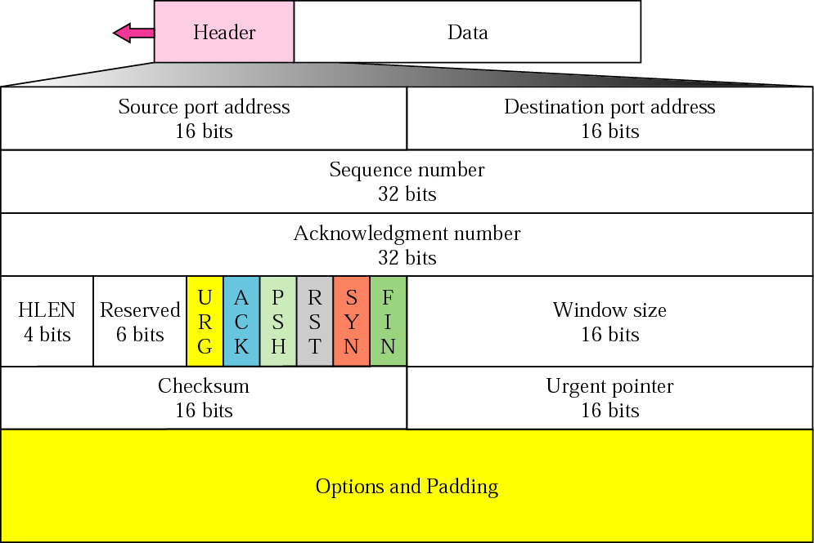
Figure 12.5 TCP segment format

Slide 16
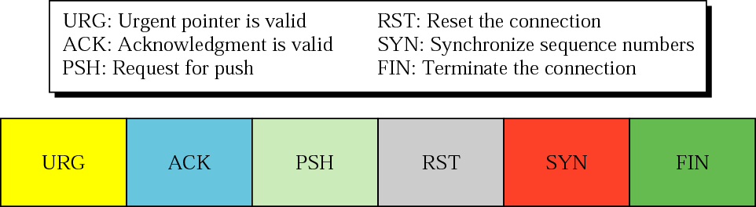
Figure 12.6 Control field

Slide 17
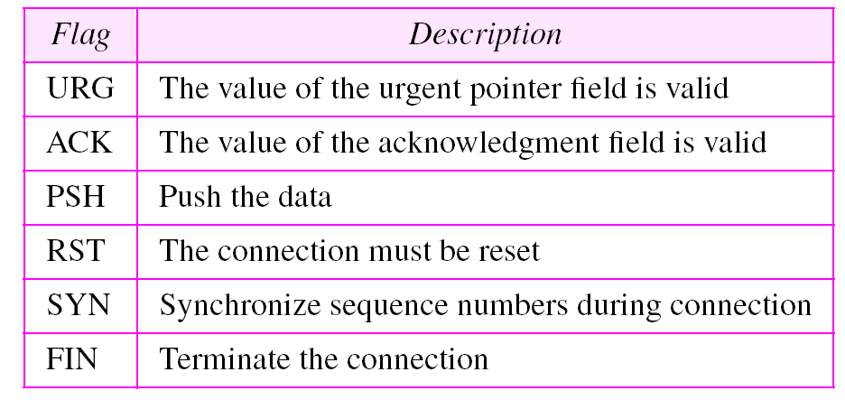
Table 12.2 Description of flags in the control field
I

Slide 18
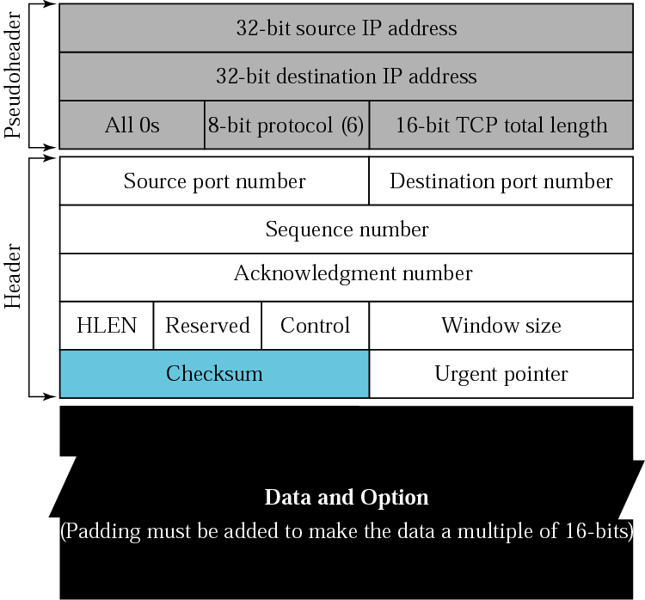
Figure 12.7 Pseudoheader added to the TCP datagram

Slide 19
Note:
The inclusion of the checksum in TCP is mandatory.

Slide 20

Figure 12.8 Encapsulation and decapsulation

Slide 21
12.4 A TCP CONNECTION
TCP is connection-oriented. A connection-oriented transport protocol establishes a virtual path between the source and destination. All of the segments belonging to a message are then sent over this virtual path. A connection-oriented transmission requires three phases: connection establishment, data transfer, and connection termination.
The topics discussed in this section include:
Connection Establishment
Data Transfer
Connection Termination
Connection Reset

Slide 22
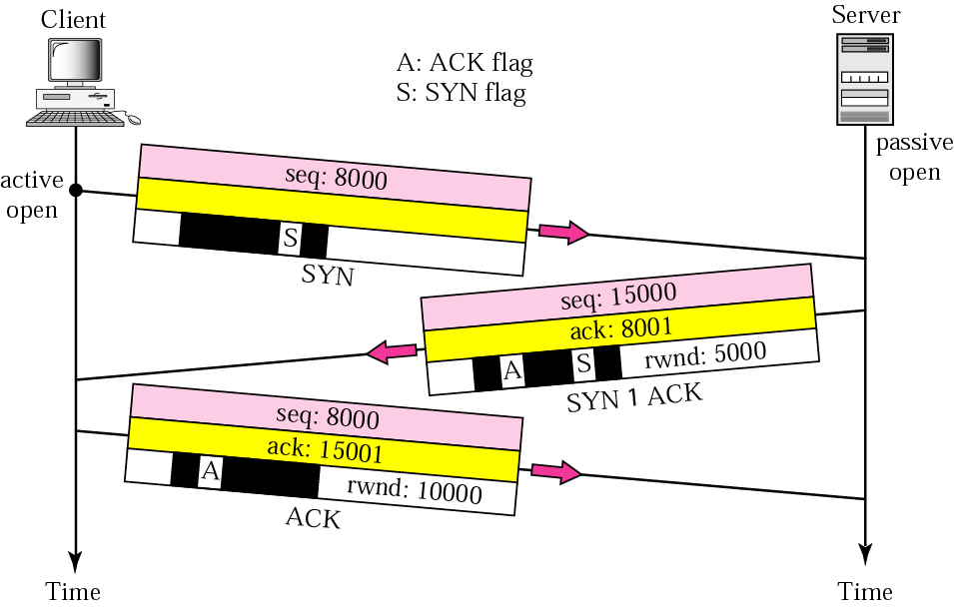
Figure 12.9 Connection establishment using three-way handshaking

Slide 23
Note:
A SYN segment cannot carry data, but it consumes one sequence number.

Slide 24
Note:
A SYN + ACK segment cannot carry data, but does consume one
sequence number.

Slide 25
Note:
An ACK segment, if carrying no data, consumes no sequence number.

Slide 26
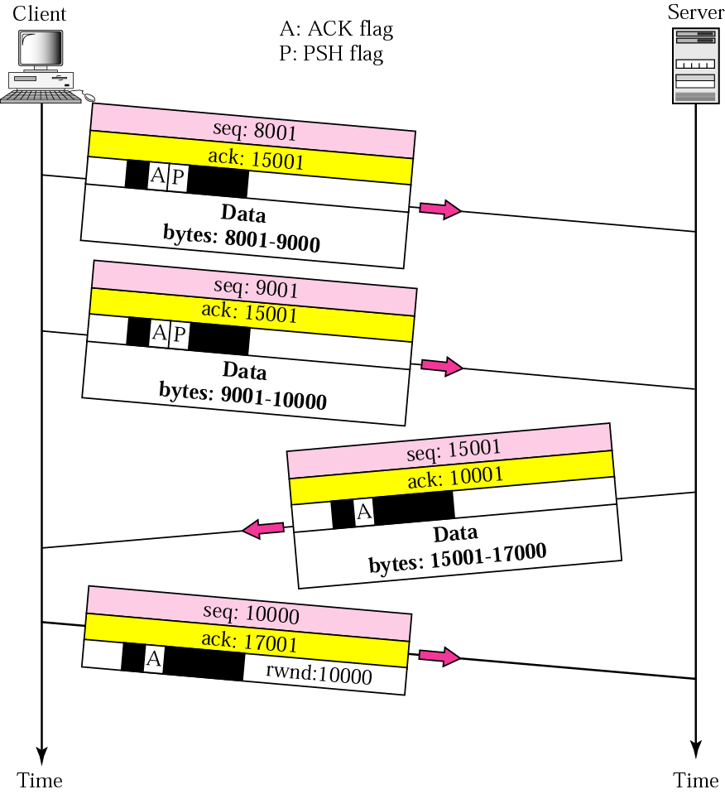
Figure 12.10 Data transfer

Slide 27
Note:
The FIN segment consumes one sequence number if it does not carry data.

Slide 28
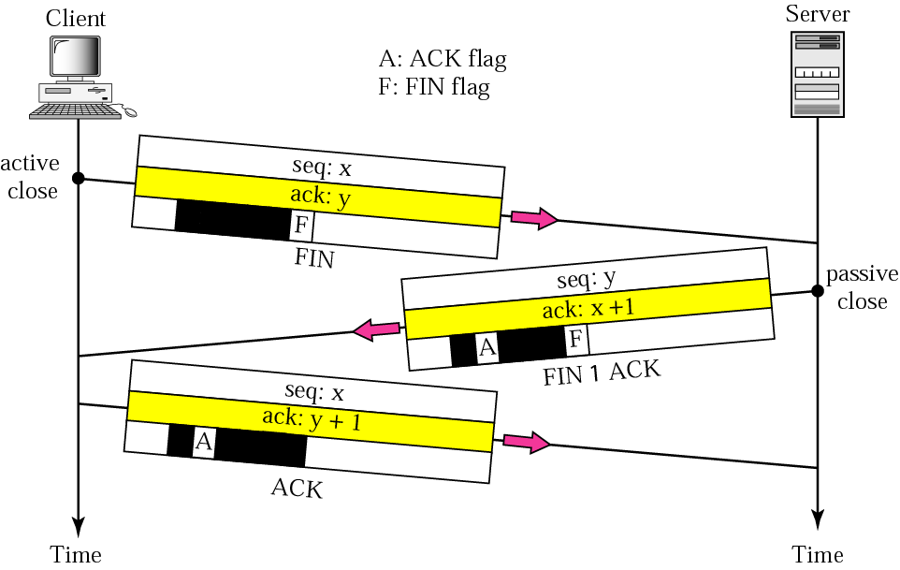
Figure 12.11 Connection termination using three-way handshaking

Slide 29
Note:
The FIN + ACK segment consumes one sequence number if it does not carry data.

Slide 30
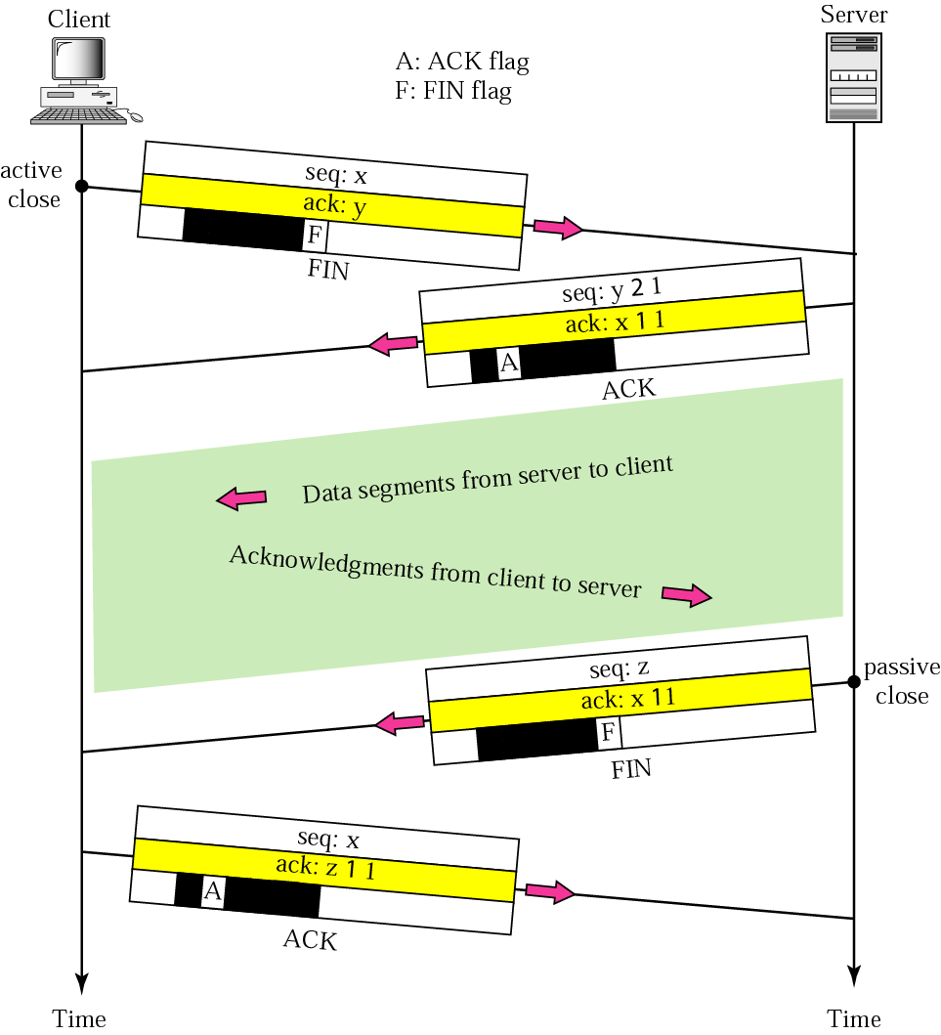
Figure 12.12 Half-close

Slide 31
12.5 STATE TRANSITION DIAGRAM
To keep track of all the different events happening during connection establishment, connection termination, and data transfer, the TCP software is implemented as a finite state machine. .
The topics discussed in this section include:
Scenarios

Slide 32
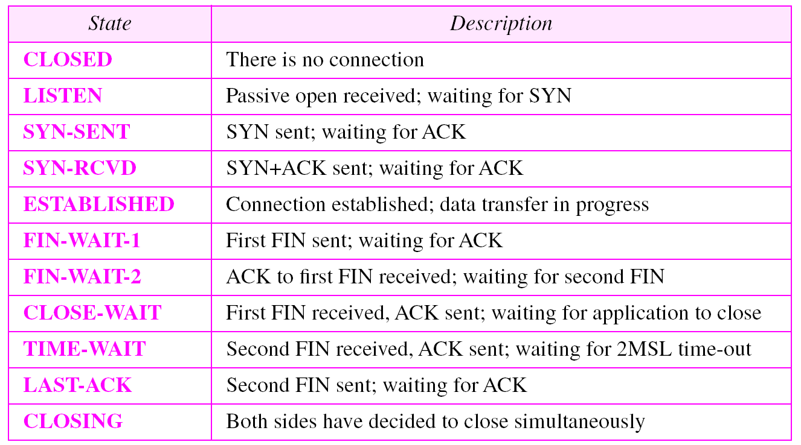
Table 12.3 States for TCP

Slide 33
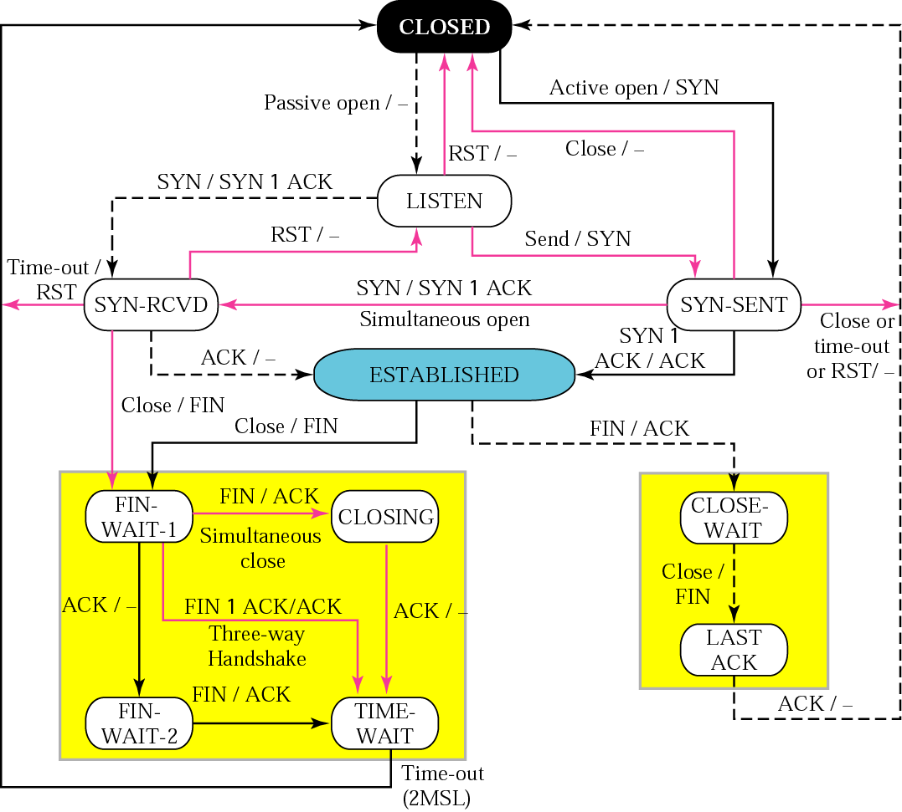
Figure 12.13 State transition diagram

Slide 34
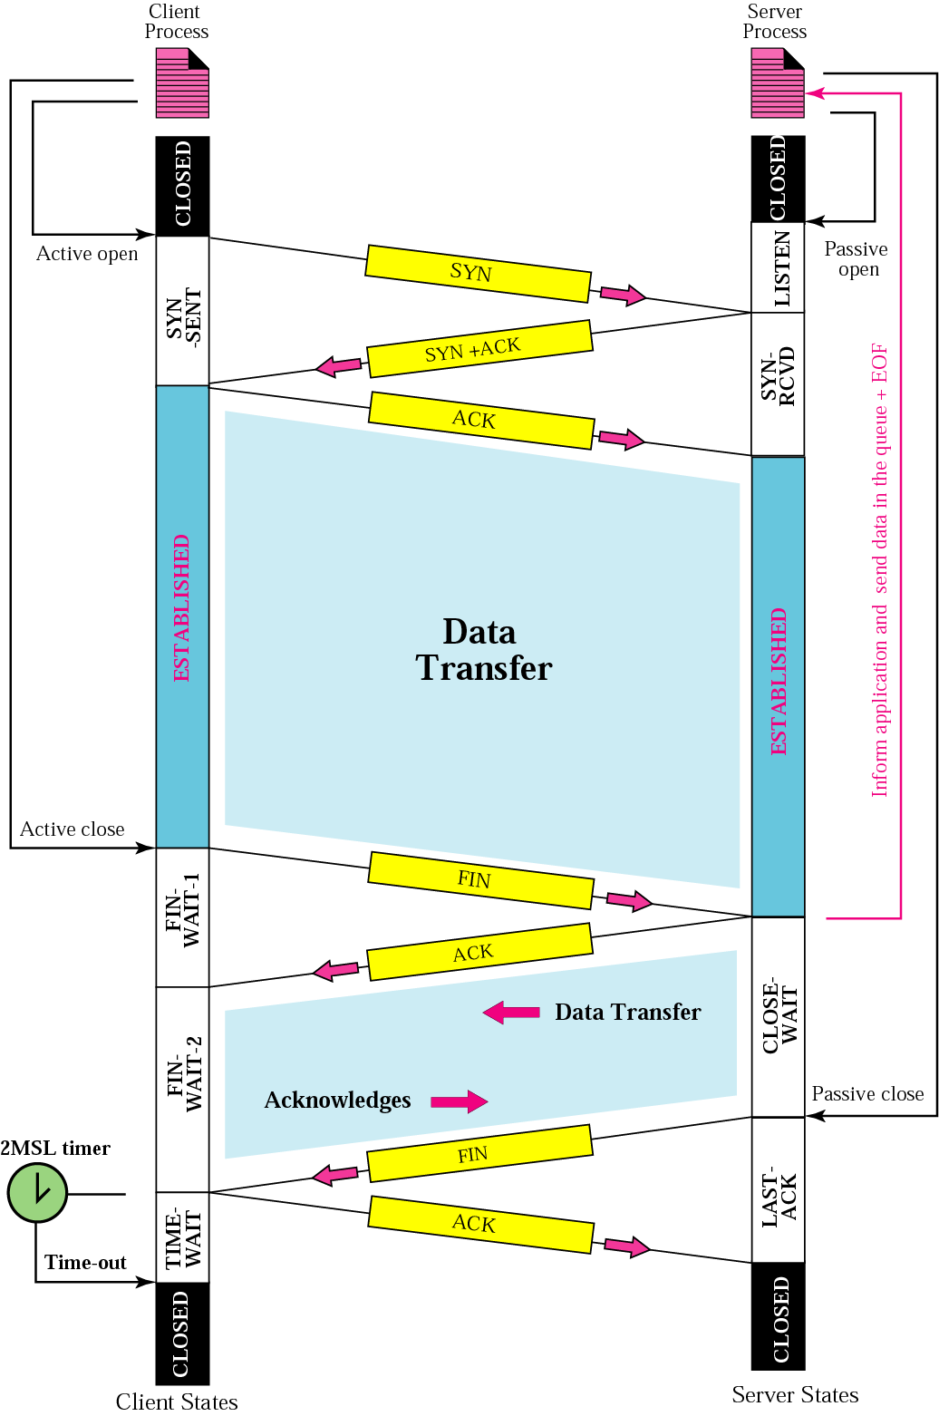
Figure 12.14 Common scenario

Slide 35
Note:
The common value for MSL is between 30 seconds and 1 minute.

Slide 36
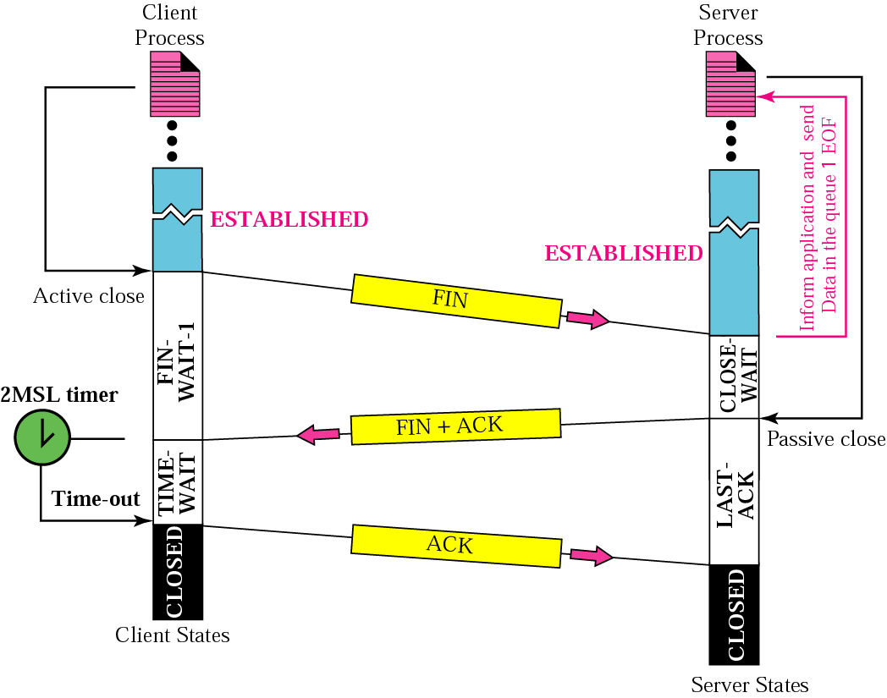
Figure 12.15 Three-way handshake

Slide 37
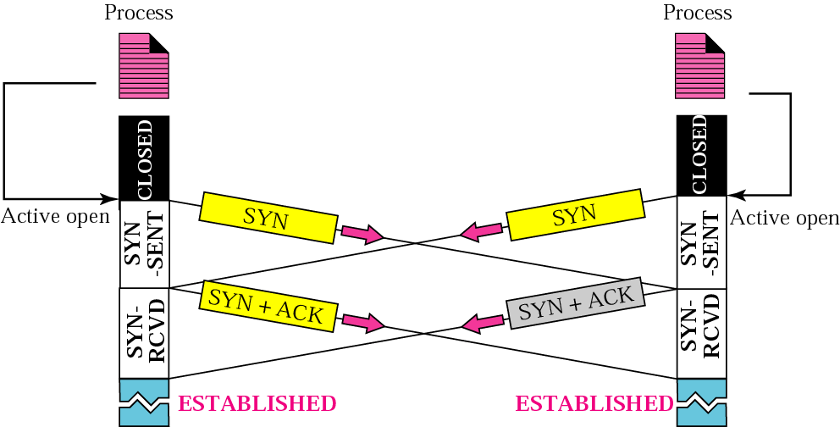
Figure 12.16 Simultaneous open

Slide 38
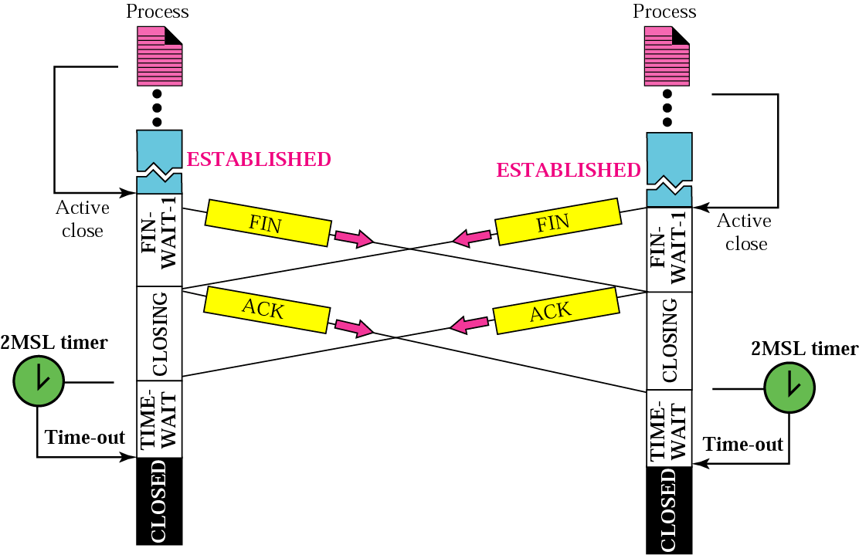
Figure 12.17 Simultaneous close

Slide 39
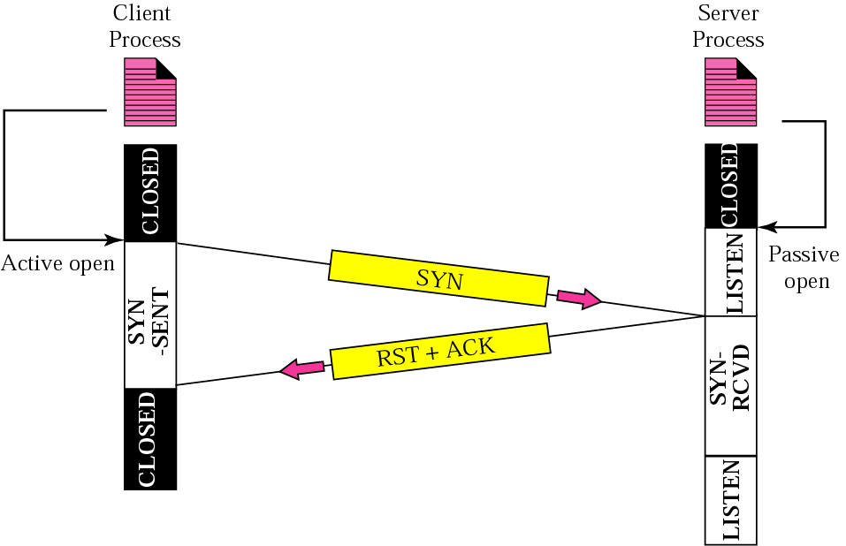
Figure 12.18 Denying a connection

Slide 40
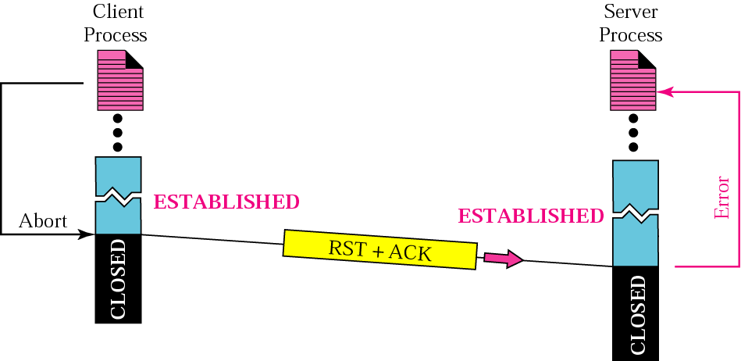
Figure 12.19 Aborting a connection

Slide 41
12.6 FLOW CONTROL
Flow control regulates the amount of data a source can send before receiving an acknowledgment from the destination. TCP defines a window that is imposed on the buffer of data delivered from the application program.
The topics discussed in this section include:
Sliding Window Protocol
Silly Window Syndrome

Slide 42
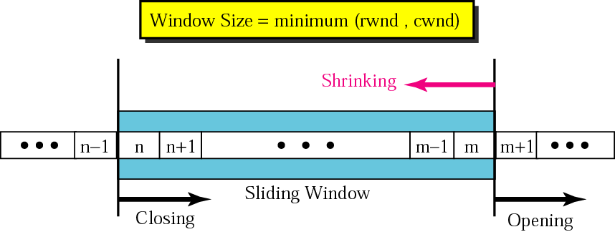
Figure 12.20 Sliding window

Slide 43
Note:
A sliding window is used to make transmission more efficient as well as to control the flow of data so that the destination does not become overwhelmed with data.
TCP’s sliding windows are byte oriented.

Slide 44
Example 3
What is the value of the receiver window (rwnd) for host A if the receiver, host B, has a buffer size of 5,000 bytes and 1,000 bytes of received and unprocessed data?
Solution
The value of rwnd = 5,000 − 1,000 = 4,000. Host B can receive only 4,000 bytes of data before overflowing its buffer. Host B advertises this value in its next segment to A.

Slide 45
Example 4
What is the size of the window for host A if the value of rwnd is 3,000 bytes and the value of cwnd is 3,500 bytes?
Solution
The size of the window is the smaller of rwnd and cwnd, which is 3,000 bytes.

Slide 46
Example 5
Figure 12.21 shows an unrealistic example of a sliding window. The sender has sent bytes up to 202. We assume that cwnd is 20 (in reality this value is thousands of bytes). The receiver has sent an acknowledgment number of 200 with an rwnd of 9 bytes (in reality this value is thousands of bytes). The size of the sender window is the minimum of rwnd and cwnd or 9 bytes. Bytes 200 to 202 are sent, but not acknowledged. Bytes 203 to 208 can be sent without worrying about acknowledgment. Bytes 209 and above cannot be sent.

Slide 47
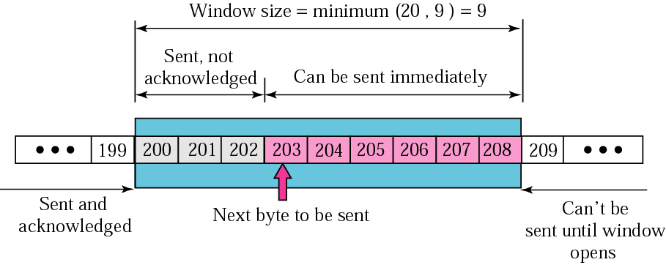
Figure 12.21 Example 5

Slide 48
Example 6
In Figure 12.21 the server receives a packet with an acknowledgment value of 202 and an rwnd of 9. The host has already sent bytes 203, 204, and 205. The value of cwnd is still 20. Show the new window.
Solution
Figure 12.22 shows the new window. Note that this is a case in which the window closes from the left and opens from the right by an equal number of bytes; the size of the window has not been changed. The acknowledgment value, 202, declares that bytes 200 and 201 have been received and the sender needs not worry about them; the window can slide over them.

Slide 49
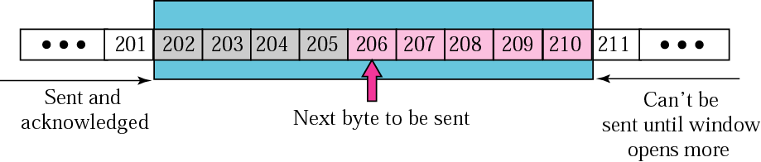
Figure 12.22 Example 6

Slide 50
Example 7
In Figure 12.22 the sender receives a packet with an acknowledgment value of 206 and an rwnd of 12. The host has not sent any new bytes. The value of cwnd is still 20. Show the new window.
Solution
The value of rwnd is less than cwnd, so the size of the window is 12. Figure 12.23 shows the new window. Note that the window has been opened from the right by 7 and closed from the left by 4; the size of the window has increased.

Slide 51
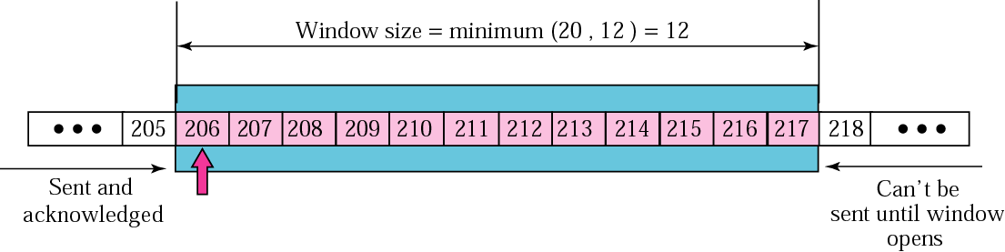
Figure 12.23 Example 7

Slide 52
Example 8
In Figure 12.23 the host receives a packet with an acknowledgment value of 210 and an rwnd of 5. The host has sent bytes 206, 207, 208, and 209. The value of cwnd is still 20. Show the new window.
Solution
The value of rwnd is less than cwnd, so the size of the window is 5. Figure 12.24 shows the situation. Note that this is a case not allowed by most implementations. Although the sender has not sent bytes 215 to 217, the receiver does not know this.

Slide 53
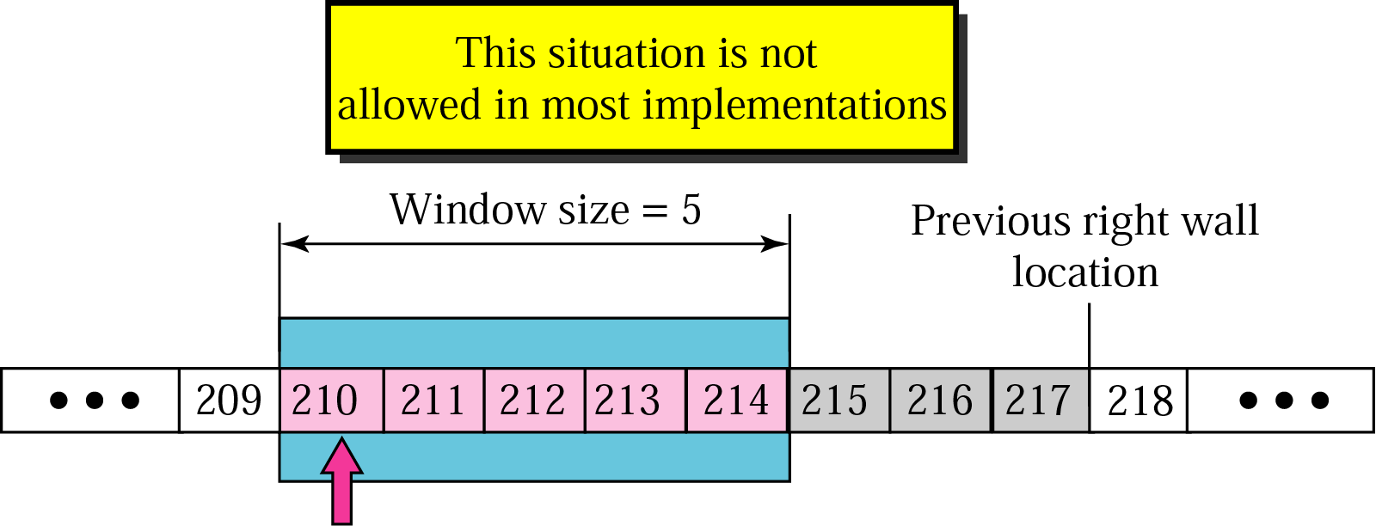
Figure 12.24 Example 8

Slide 54
Example 9
How can the receiver avoid shrinking the window in the previous example?
Solution
The receiver needs to keep track of the last acknowledgment number and the last rwnd. If we add the acknowledgment number to rwnd we get the byte number following the right wall. If we want to prevent the right wall from moving to the left (shrinking), we must always have the following relationship.
new ack + new rwnd ≥ last ack + last rwnd
or
new rwnd ≥ (last ack + last rwnd) − new ack

Slide 55
Note:
To avoid shrinking the sender window, the receiver must wait until more space is available in its buffer.

Slide 56
Note:
Some points about TCP’s sliding windows:
❏ The size of the window is the lesser of rwnd and cwnd.
❏ The source does not have to send a full window’s
worth of data.
❏ The window can be opened or closed by the receiver,
but should not be shrunk.
❏ The destination can send an acknowledgment at any
time as long as it does not result in a shrinking window.
❏ The receiver can temporarily shut down the window;
the sender, however, can always send a segment of one
byte after the window is shut down.

Slide 57
12.7 ERROR CONTROL
TCP provides reliability using error control, which detects corrupted, lost, out-of-order, and duplicated segments. Error control in TCP is achieved through the use of the checksum, acknowledgment, and time-out.
The topics discussed in this section include:
Checksum
Acknowledgment
Acknowledgment Type
Retransmission
Out-of-Order Segments
Some Scenarios

Slide 58
Note:
ACK segments do not consume sequence numbers and are not acknowledged.

Slide 59
Note:
In modern implementations, a retransmission occurs if the retransmission timer expires or three duplicate ACK segments have arrived.

Slide 60
Note:
No retransmission timer is set for an ACK segment.

Slide 61
Note:
Data may arrive out of order and be temporarily stored by the receiving TCP, but TCP guarantees that no out-of-order segment is delivered to the process.

Slide 62
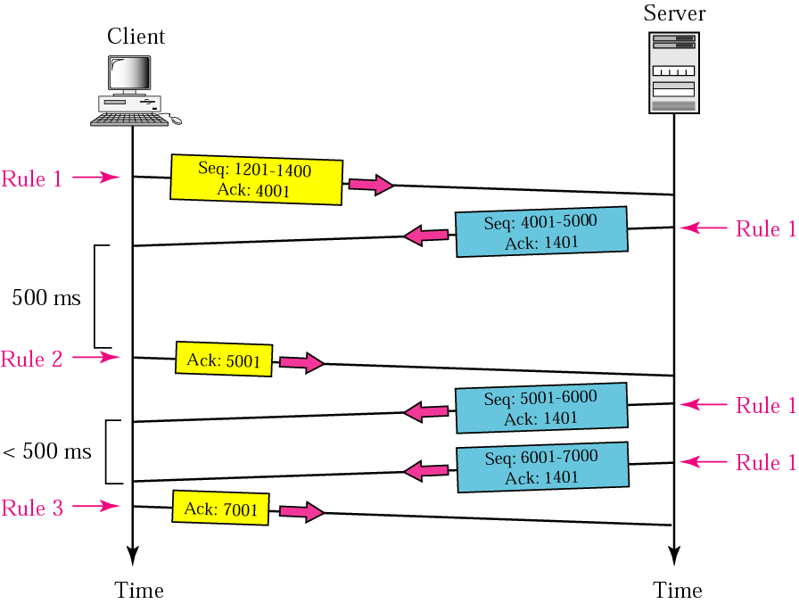
Figure 12.25 Normal operation

Slide 63
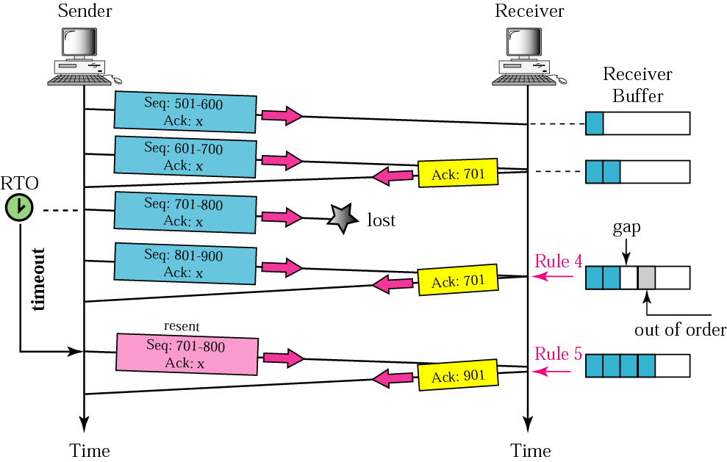
Figure 12.26 Lost segment

Slide 64
Note:
The receiver TCP delivers only ordered data to the process.

Slide 65
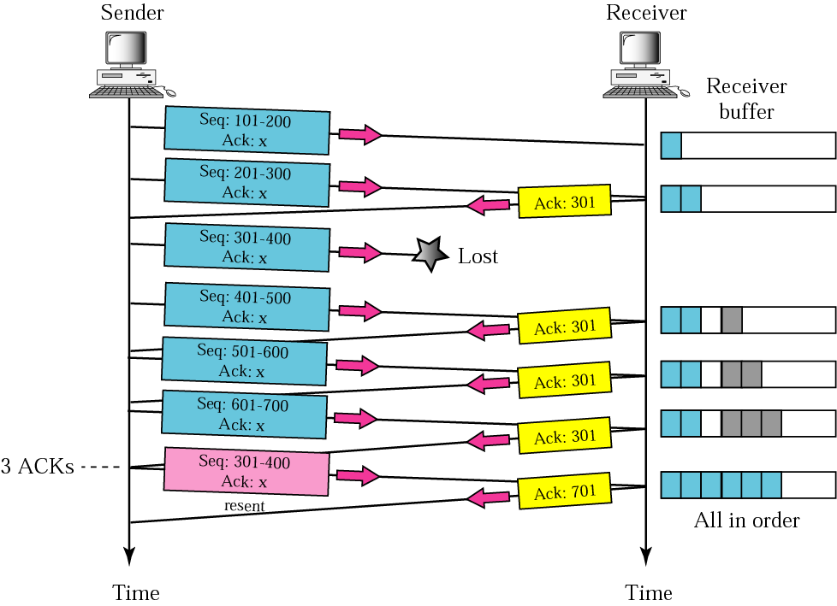
Figure 12.27 Fast retransmission

Slide 66
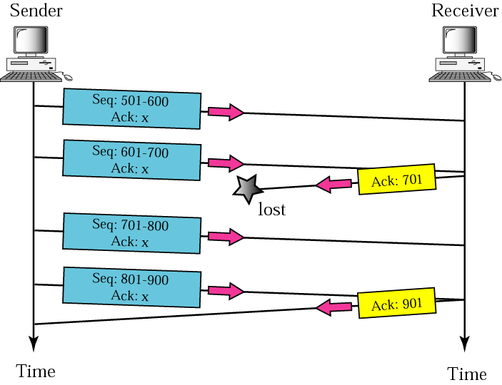
Figure 12.28 Lost acknowledgment

Slide 67
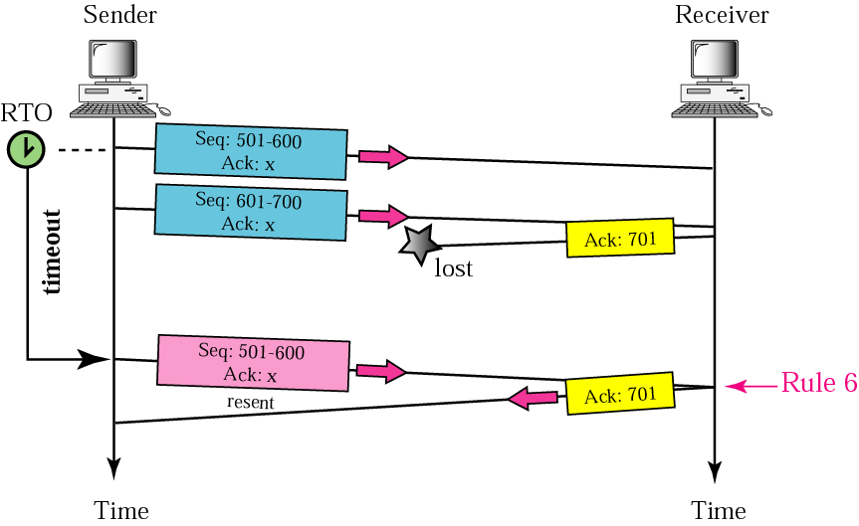
Figure 12.29 Lost acknowledgment corrected by resending a segment

Slide 68
Note:
Lost acknowledgments may create deadlock if they are not properly handled.

Slide 69
12.8 CONGESTION CONTROL
Congestion control refers to the mechanisms and techniques to keep the load below the capacity.
The topics discussed in this section include:
Network Performance
Congestion Control Mechanisms
Congestion Control in TCP

Slide 70
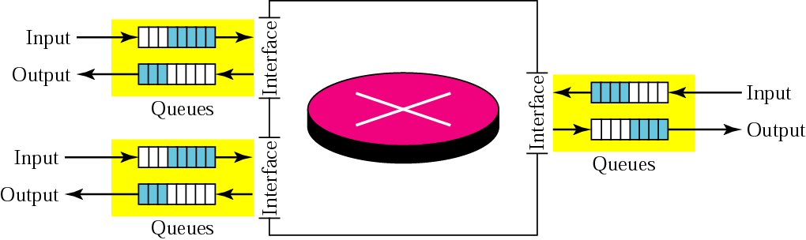
Figure 12.30 Router queues

Slide 71
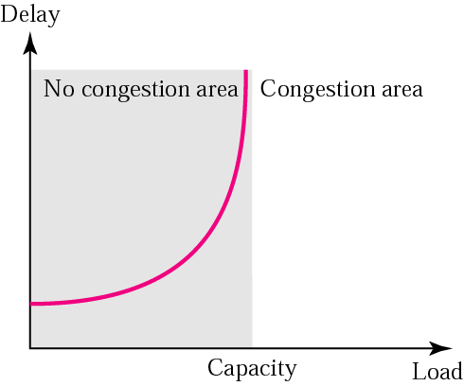
Figure 12.31 Packet delay and network load

Slide 72
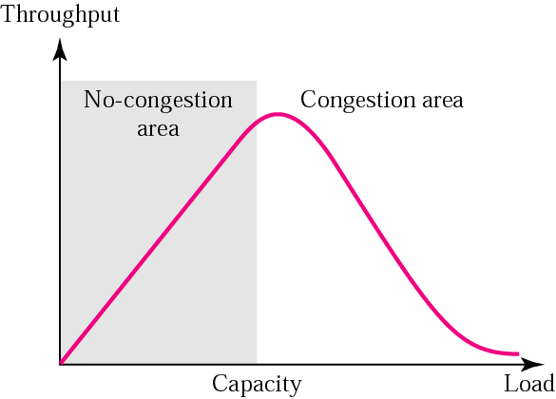
Figure 12.32 Throughput versus network load

Slide 73
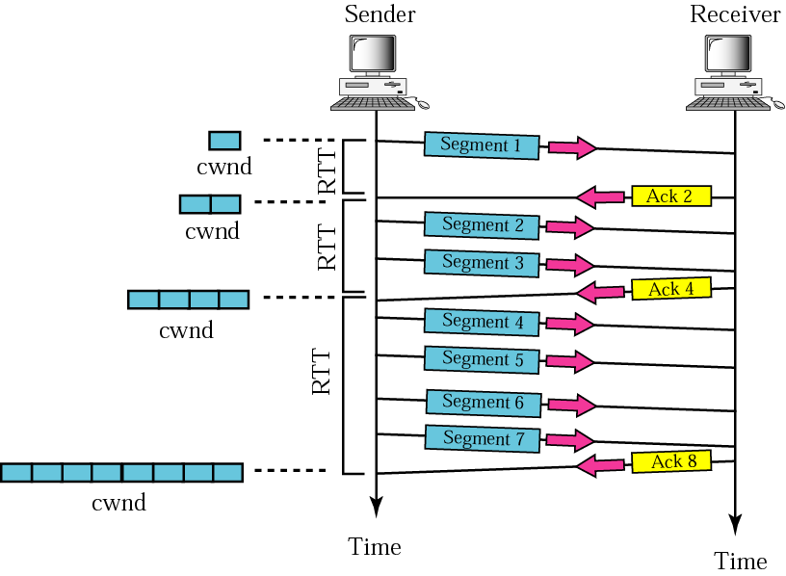
Figure 12.33 Slow start, exponential increase

Slide 74
Note:
In the slow start algorithm, the size of the congestion window increases exponentially until it reaches a threshold.

Slide 75
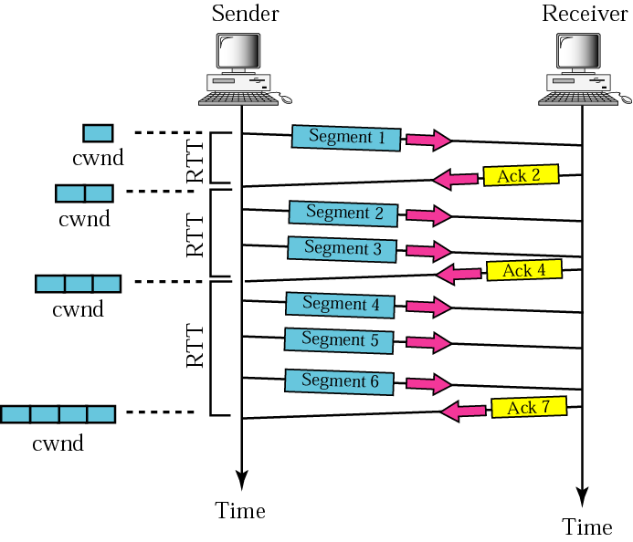
Figure 12.34 Congestion avoidance, additive increase

Slide 76
Note:
In the congestion avoidance algorithm the size of the congestion window increases additively until
congestion is detected.

Slide 77
Note:
Most implementations react differently to congestion detection:
❏ If detection is by time-out, a new slow start phase
starts.
❏ If detection is by three ACKs, a new congestion
avoidance phase starts.

Slide 78
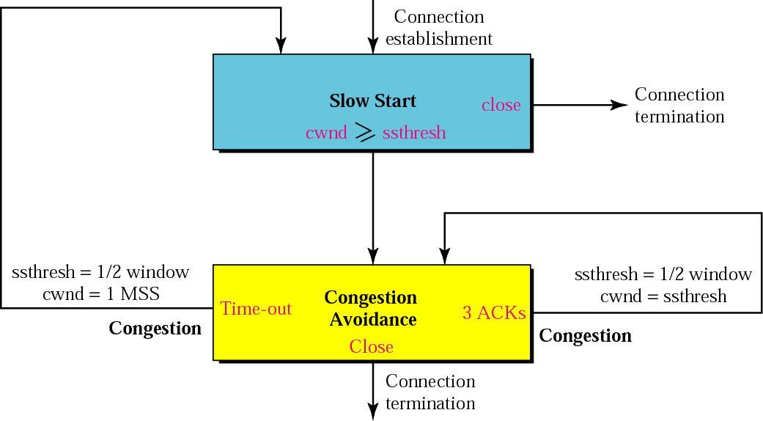
Figure 12.35 TCP congestion policy summary

Slide 79
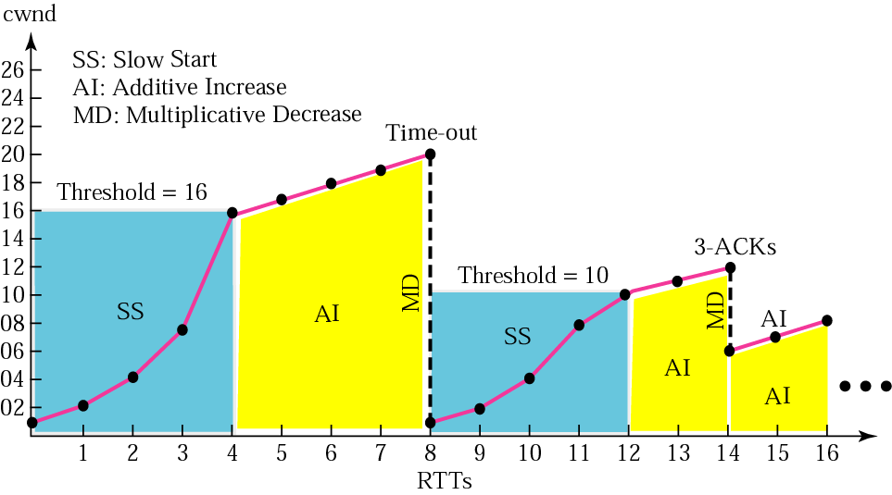
Figure 12.36 Congestion example

Slide 80
12.9 TCP TIMERS
To perform its operation smoothly, most TCP implementations use at least four timers.
The topics discussed in this section include:
Retransmission Timer
Persistence Timer
Keepalive Timer
TIME-WAIT Timer

Slide 81
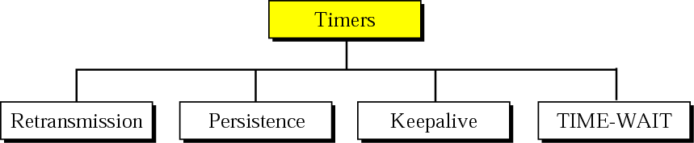
Figure 12.37 TCP timers

Slide 82
Note:
In TCP, there can be only be one RTT measurement in progress at any time.

Slide 83
Example 10
Let us give a hypothetical example. Figure 12.38 shows part of a connection. The figure shows the connection establishment and part of the data transfer phases.
1. When the SYN segment is sent, there is no value for RTT_{M} , RTT_{S} , or RTT_{D} . The value of RTO is set to 6.00 seconds. The following shows the value of these variables at this moment:
RTT_{M} = 1.5 RTT_{S} = 1.5
RTT_{D} = 1.5 / 2 = 0.75 RTO = 1.5 + 4 . 0.75 = 4.5
2. When the SYN+ACK segment arrives, RTT_{M} is measured and is equal to 1.5 seconds. The next slide shows the values of these variables:

Slide 84
Example 10 (continued)
RTT_{M} = 1.5 RTT_{S} = 1.5
RTT_{D} = 1.5 / 2 = 0.75 RTO = 1.5 + 4 . 0.75 = 4.5
3.When the first data segment is sent, a new RTT measurement starts. Note that the sender does not start an RTT measurement when it sends the ACK segment, because it does not consume a sequence number and there is no time-out. No RTT measurement starts for the second data segment because a measurement is already in progress.
RTT_{M} = 2.5
RTT_{S} = 7/8 (1.5) + 1/8 (2.5) = 1.625
RTT_{D} = 3/4 (7.5) + 1/4 |1.625 − 2.5| = 0.78
RTO = 1.625 + 4 (0.78) = 4.74

Slide 85
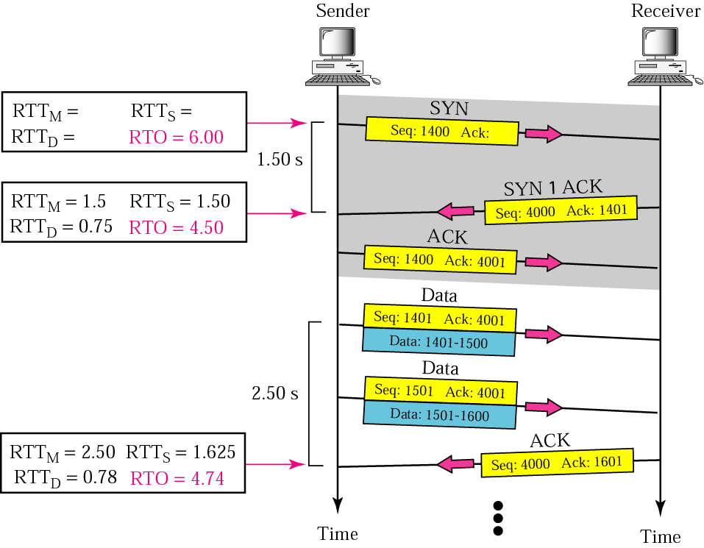
Figure 12.38 Example 10

Slide 86
Note:
TCP does not consider the RTT of a retransmitted segment in its calculation of a new RTO.

Slide 87
Example 11
Figure 12.39 is a continuation of the previous example. There is retransmission and Karn’s algorithm is applied. The first segment in the figure is sent, but lost. The RTO timer expires after 4.74 seconds. The segment is retransmitted and the timer is set to 9.48, twice the previous value of RTO. This time an ACK is received before the time-out. We wait until we send a new segment and receive the ACK for it before recalculating the RTO (Karn’s algorithm).

Slide 88
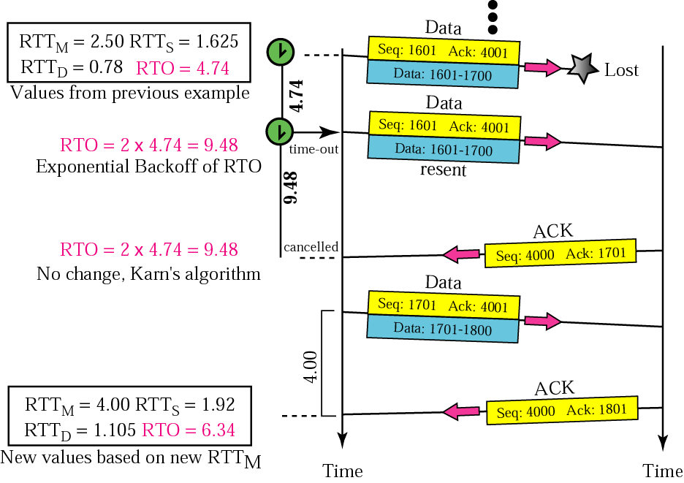
Figure 12.39 Example 11

Slide 89
12.10 OPTIONS
The TCP header can have up to 40 bytes of optional information. Options convey additional information to the destination or align other options.

Slide 90
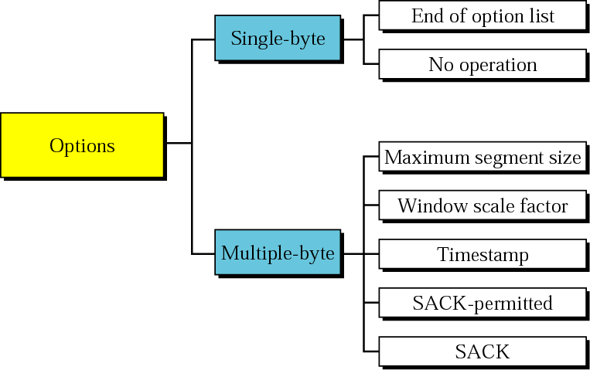
Figure 12.40 Options

Slide 91
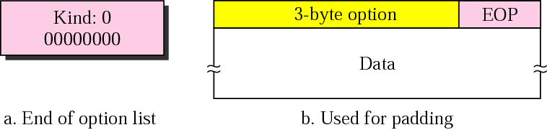
Figure 12.41 End-of-option option

Slide 92
Note:
EOP can be used only once.

Slide 93
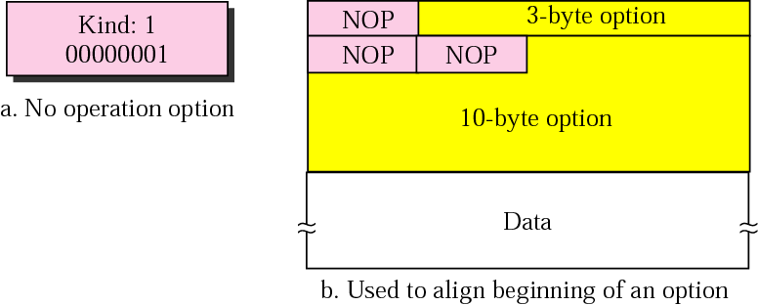
Figure 12.42 No-operation option

Slide 94
Note:
NOP can be used more than once.

Slide 95
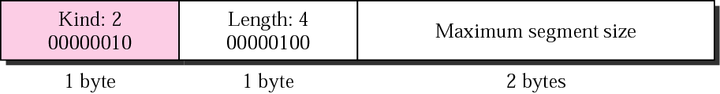
Figure 12.43 Maximum-segment-size option

Slide 96
Note:
The value of MSS is determined during connection establishment and does not change during the connection.

Slide 97
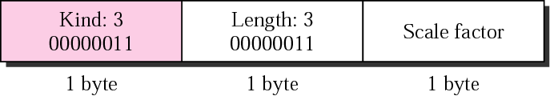
Figure 12.44 Window-scale-factor option

Slide 98
Note:
The value of the window scale factor can be determined only during connection establishment; it does not change during the connection.

Slide 99
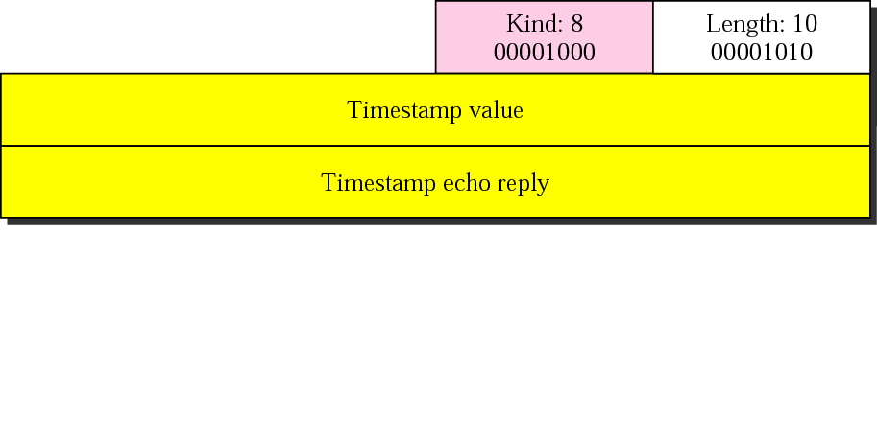
Figure 12.45 Timestamp option

Slide 100
Note:
One application of the timestamp option is the calculation of round trip time (RTT).

Slide 101
Example 12
Figure 12.46 shows an example that calculates the round-trip time for one end. Everything must be flipped if we want to calculate the RTT for the other end.
The sender simply inserts the value of the clock (for example, the number of seconds past from midnight) in the timestamp field for the first and second segment. When an acknowledgment comes (the third segment), the value of the clock is checked and the value of the echo reply field is subtracted from the current time. RTT is 12 s in this scenario.

Slide 102
Example 12 (Continued)
The receiver’s function is more involved. It keeps track of the last acknowledgment sent (12000). When the first segment arrives, it contains the bytes 12000 to 12099. The first byte is the same as the value of lastack. It then copies the timestamp value (4720) into the tsrecent variable. The value of lastack is still 12000 (no new acknowledgment has been sent). When the second segment arrives, since none of the byte numbers in this segment include the value of lastack, the value of the timestamp field is ignored. When the receiver decides to send an accumulative acknowledgment with acknowledgment 12200, it changes the value of lastack to 12200 and inserts the value of tsrecent in the echo reply field. The value of tsrecent will not change until it isreplaced by a new segment that carries byte 12200 (next segment).

Slide 103
Example 12 (Continued)
Note that as the example shows, the RTT calculated is the time difference between sending the first segment and receiving the third segment. This is actually the meaning of RTT: the time difference between a packet sent and the acknowledgment received. The third segment carries the acknowledgment for the first and second segments.

Slide 104
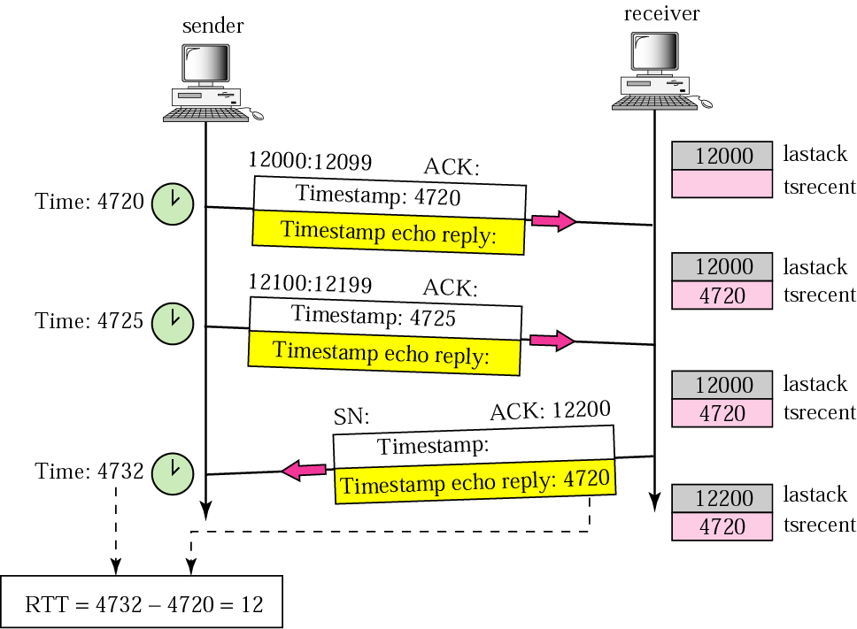
Figure 12.46 Example 12

Slide 105
Note:
The timestamp option can also be used for PAWS.

Slide 106
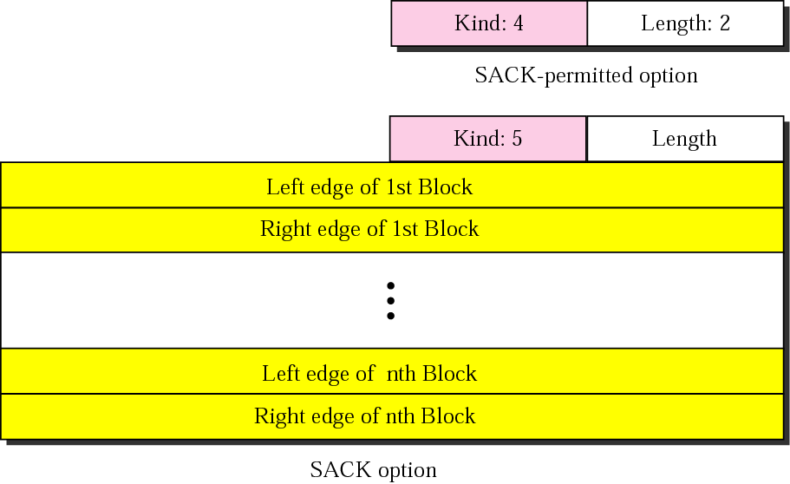
Figure 12.47 SACK

Slide 107
Example 13
Let us see how the SACK option is used to list out-of-order blocks. In Figure 12.48 an end has received five segments of data.
The first and second segments are in consecutive order. An accumulative acknowledgment can be sent to report the reception of these two segments. Segments 3, 4, and 5, however, are out of order with a gap between the second and third and a gap between the fourth and the fifth. An ACK and a SACK together can easily clear the situation for the sender. The value of ACK is2001, which means that the sender need not worry about bytes 1 to 2000. The SACK has two blocks. The first block announces that bytes 4001 to 6000 have arrived out of order. The second block shows that bytes 8001 to 9000 have also arrived out of order. This means that bytes 2001 to 4000 and bytes 6001 to 8000 are lost or discarded. The sender can resend only these bytes.

Slide 108
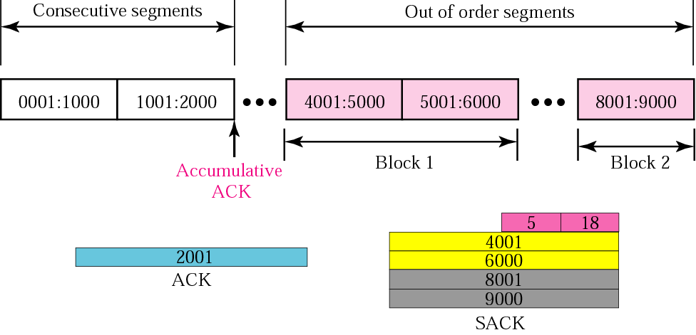
Figure 12.48 Example 13

Slide 109
Example 14
The example in Figure 12.49 shows how a duplicate segment can be detected with a combination of ACK and SACK. In this case, we have some out-of-order segments (in one block) and one duplicate segment. To show both out-of-order and duplicate data, SACK uses the first block, in this case, to show the duplicate data and other blocks to show out-of-order data. Note that only the first block can be used for duplicate data. The natural question is how the sender, when it receives these ACK and SACK values knows that the first block is for duplicate data (compare this example with the previous example). The answer is that the bytes in the first block are already acknowledged in the ACK field; therefore, this block must be a duplicate.

Slide 110

Figure 12.49 Example 14

Slide 111
Example 15
The example in Figure 12.50 shows what happens if one of the segments in the out-of-order section is also duplicated. In this example, one of the segments (4001:5000) is duplicated. The SACK option announces this duplicate data first and then the out-of-order block. This time, however, the duplicated block is not yet acknowledged by ACK, but because it is part of the out-of-order block (4001:5000 is part of 4001:6000), it is understood by the sender that it defines the duplicate data.

Slide 112

Figure 12.50 Example 15

Slide 113
12.11 TCP PACKAGE
We present a simplified, bare-bones TCP package to simulate the heart of TCP. The package involves tables called transmission control blocks, a set of timers, and three software modules.
The topics discussed in this section include:
Transmission Control Blocks (TCBs)
Timers
Main Module
Input Processing Module
Output Processing Module

Slide 114

Figure 12.51 TCP package

Slide 115

Figure 12.52 TCBs

